Slide 1
Communication and its Types
Department of English and Foreign Languages SRM Institute of Science and Technology

Slide 2
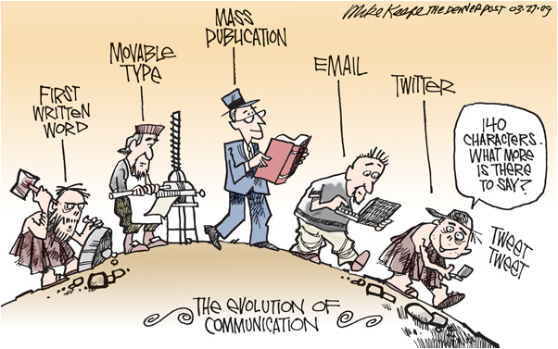
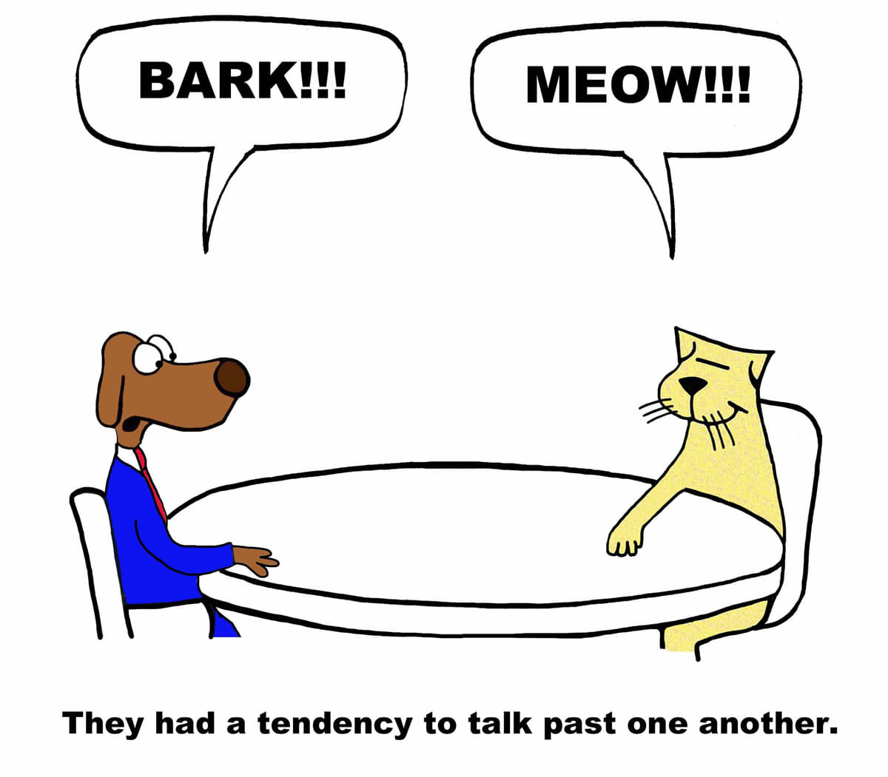
Let’s Define Communication …
Media critic and theorist James Carey defined communication as "a symbolic process whereby reality is produced, maintained, repaired and transformed" in his 1992 book "Communication as Culture," positing that we define our reality via sharing our experience with others.
All creatures on earth have developed means in which to convey their emotions and thoughts to one another. However, it's the ability of humans to use words and language to transfer specific meanings that sets them apart from the animal kingdom.

Slide 3
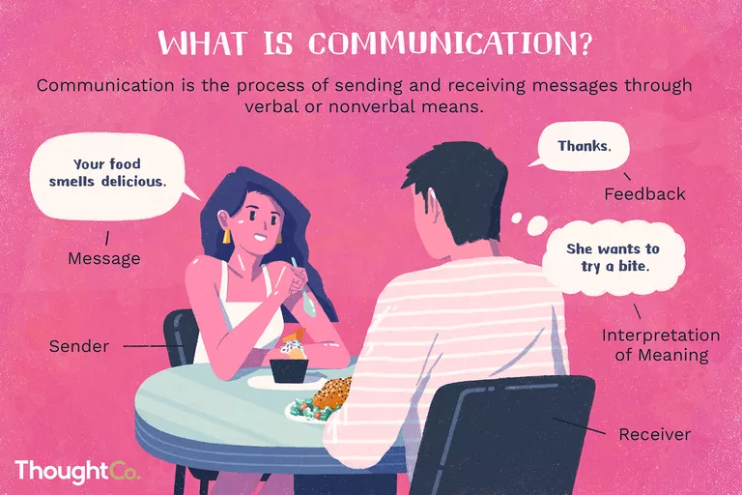

Slide 4
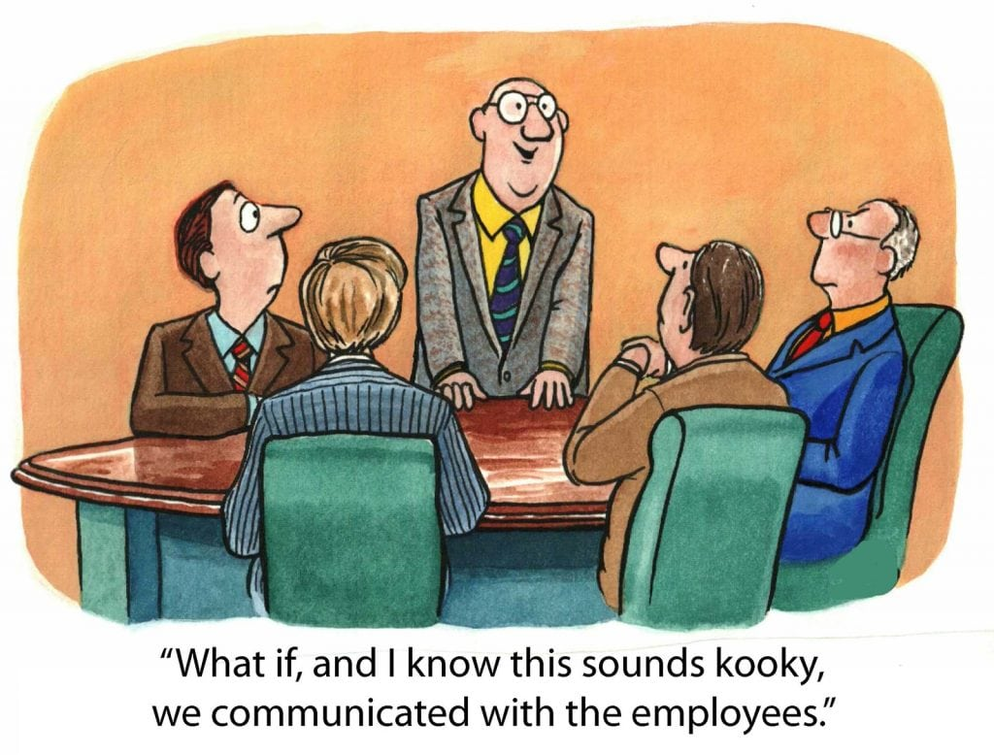
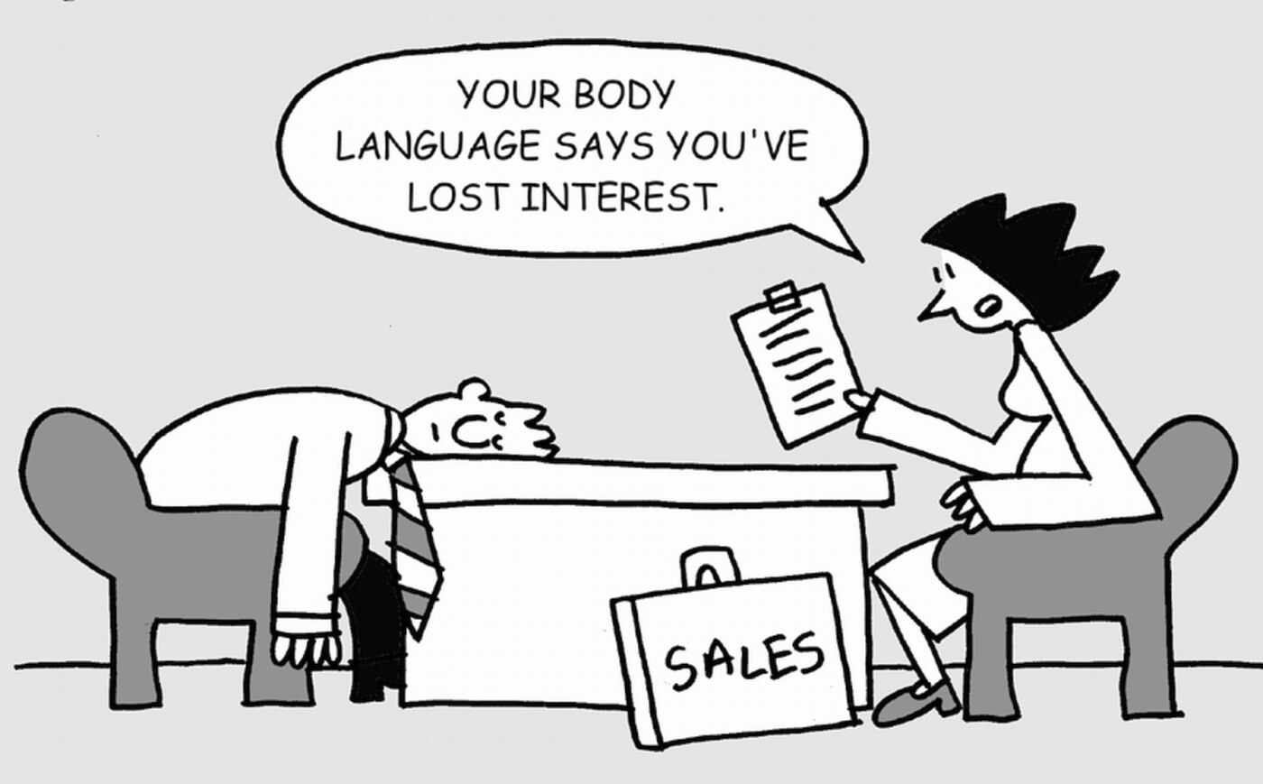
Verbal Communication
1.Oral
2. Written
Non Verbal Communication
1. kinesics (Body language)
2. Haptics (Touch )
3. Proxemics (Space distancing)
4. Chronemics
5.Sign language
6.para language

Slide 5
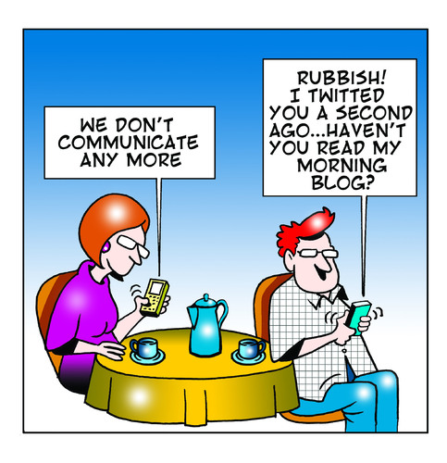
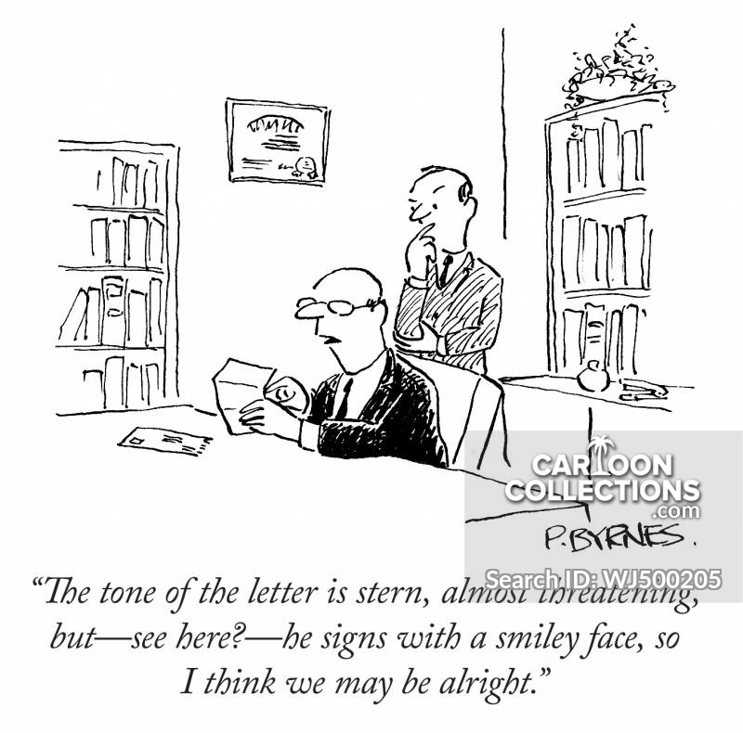
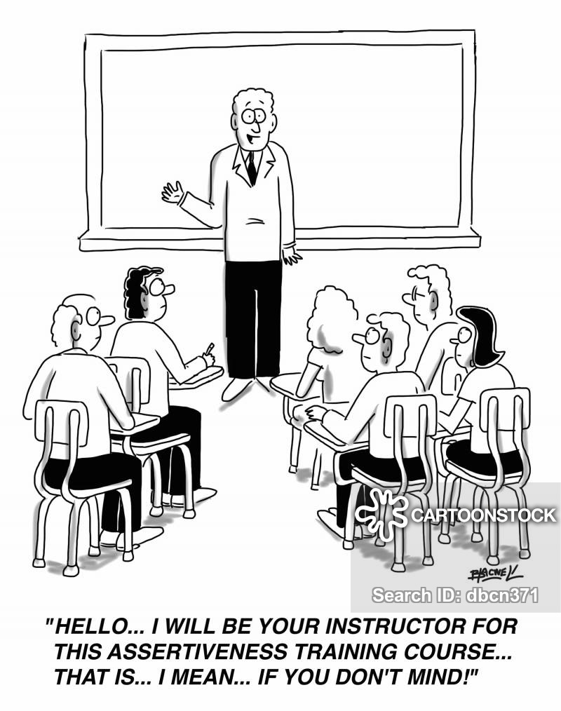
VERBAL C OMMUNICATION
the form of communication in which message is transmitted verbally
Verbal communication is done by words, mouth or writing.
Objective is to make people understood what we are trying to say

Slide 6
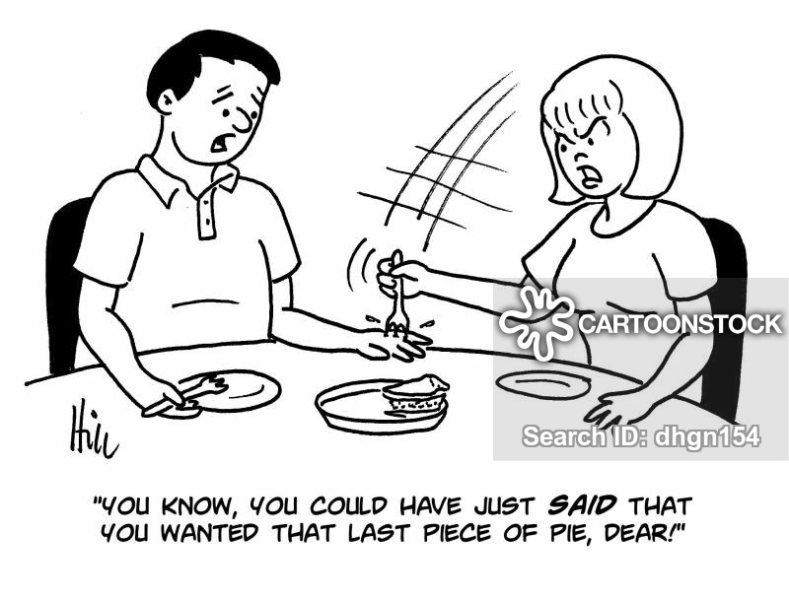
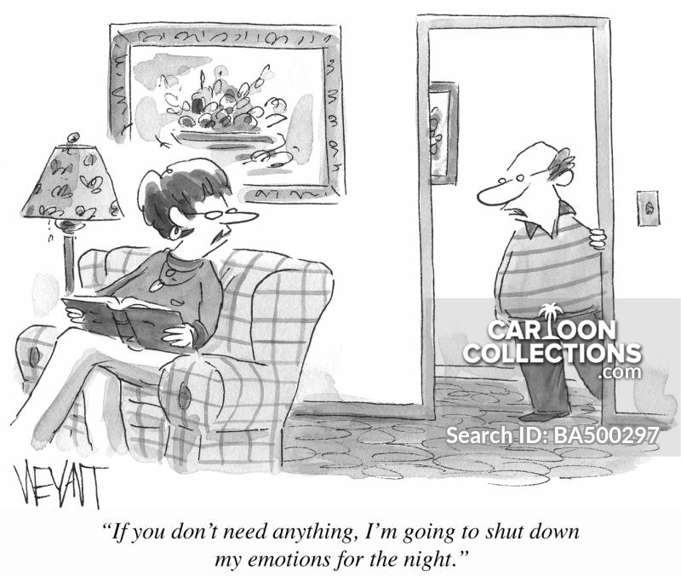
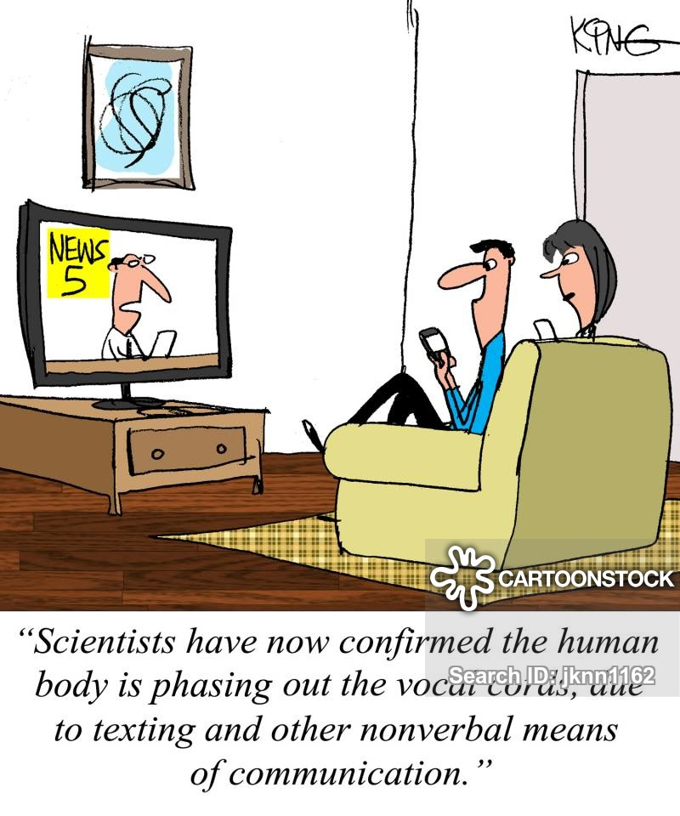
ORALCOMMUNICATION
➢In oral communication, Spoken words are used.
➢It includes face-to-face conversations, speech, telephonic conversation, video, radio, television, voice over internet.
➢Communication is influence by volume, speed and clarity of speaking.

Slide 7
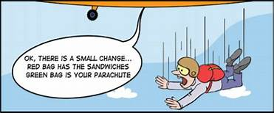
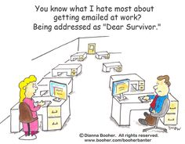
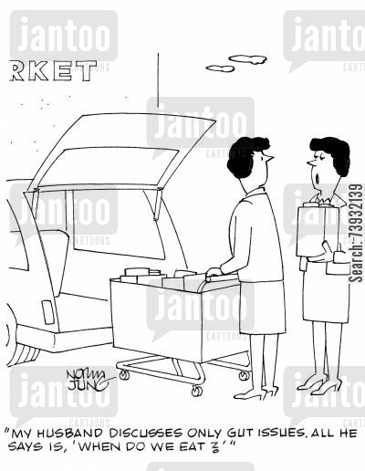
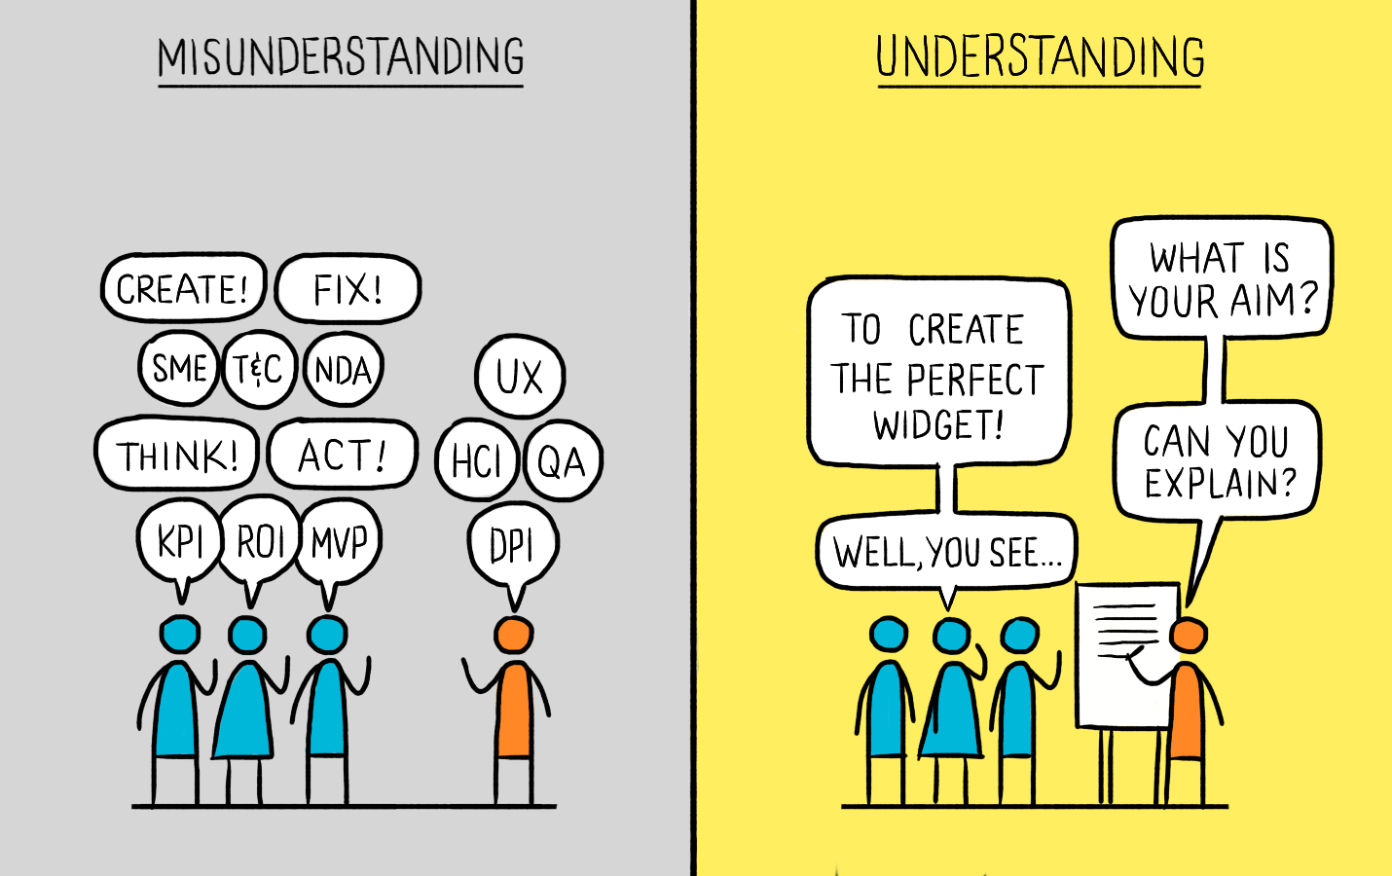
ORALCOMMUNICATION
Advantages
▪Quickness in exchange of
Ideas.
▪Quick feedback
▪Flexibility.
▪Personal touch
▪Removal of misunderstanding
Disadvantages
▪Unfit for lengthy message.
▪Unfit for policy matters.
▪Lack of written proof.
▪Expensive method.
▪Lack of clarity.
▪Misuse of time.
▪Presence of both the parties is necessary.

Slide 8
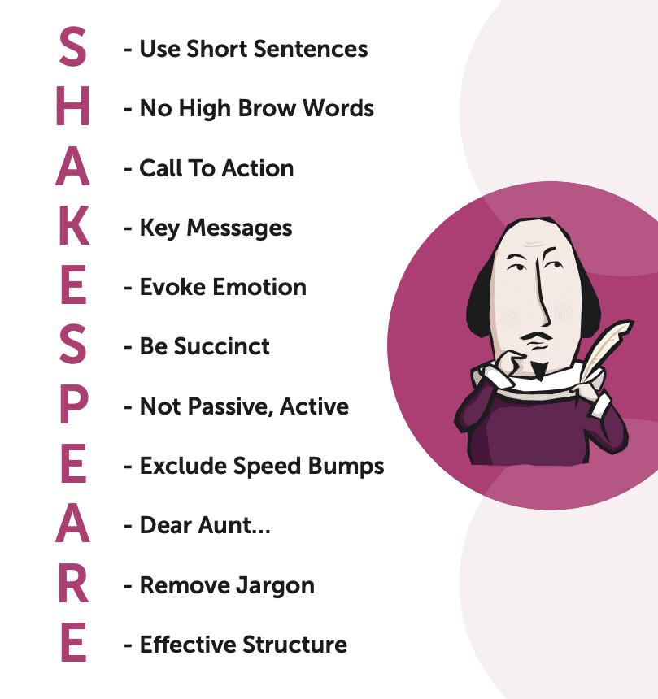
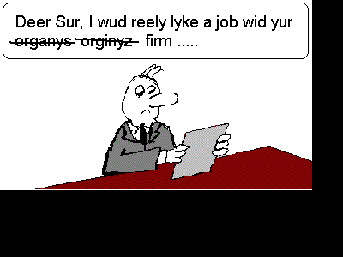
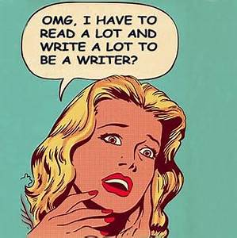
WRITTEN C OMMUNICATION
In written communication, written signs or symbols
are used to communicate.
In written communication message can be
transmitted via email, letter, report, memo etc.
In written communication, is influenced by the
vocabulary & grammar used, writing style, precision
and clarity of the language used.

Slide 9
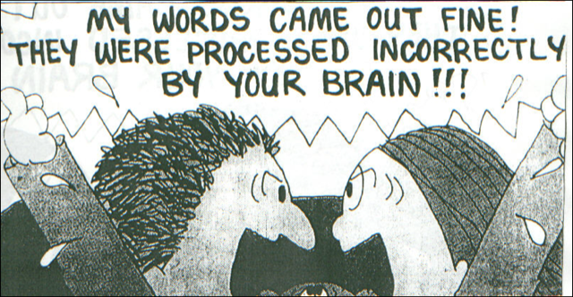
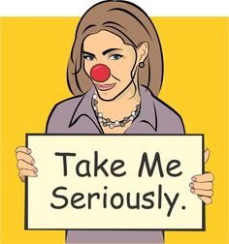
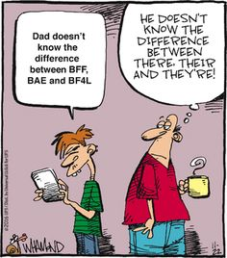
WRITTENCOMMUNICATION
ADVANTAGES
▪Suitable for lengthy messages
▪Written proof
▪Clear message
▪Less expensive method
▪Presence of both the parties .
▪is not necessary
▪True and effective
DISADVANTAGES
▪Unfit for uneducated persons
▪Lack of secrecy
▪No quick feedback.

Slide 10
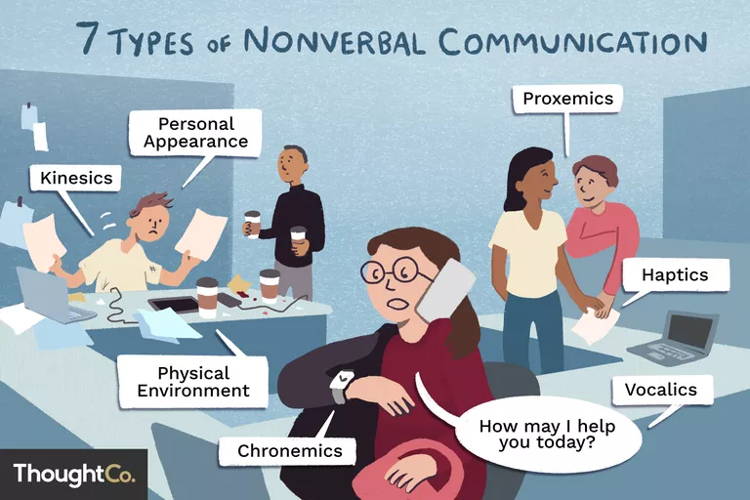
Nonverbal communication, also called manual language, is the process of sending and receiving messages without using words, either spoken or written. Similar to the way that italicizing emphasizes written language, nonverbal behavior may emphasize parts of a verbal message.

Slide 12
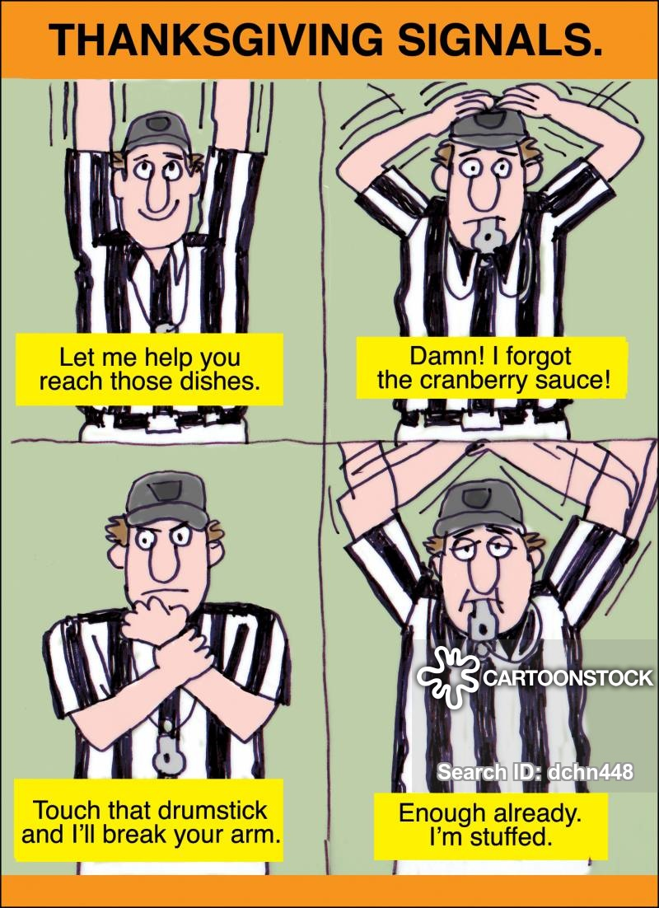
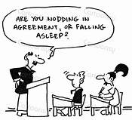
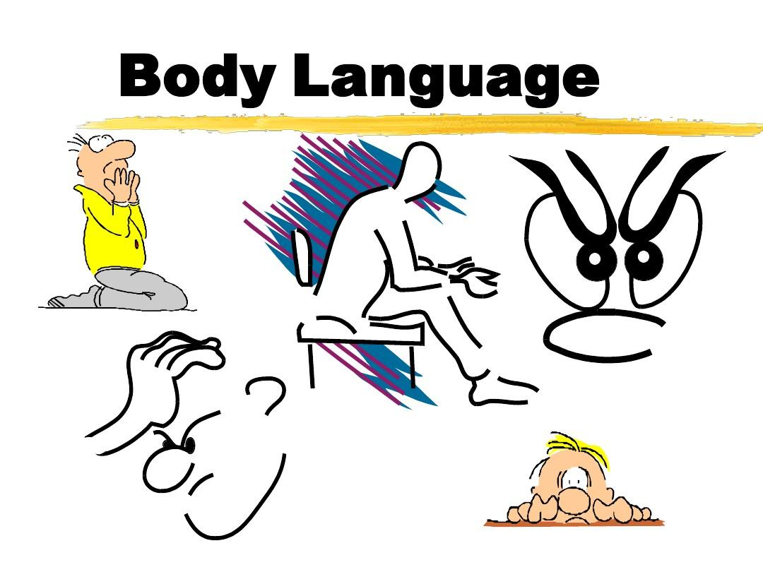

Slide 13

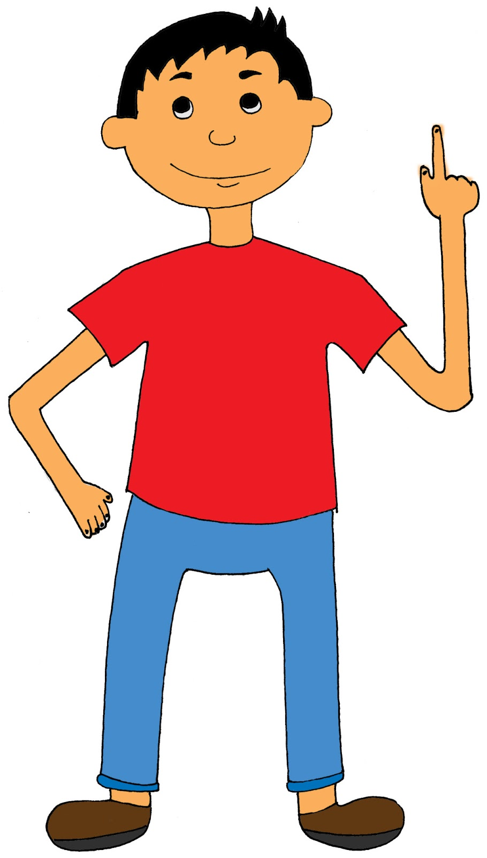
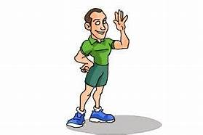
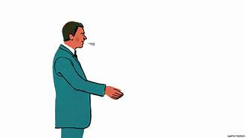
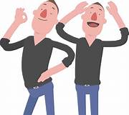
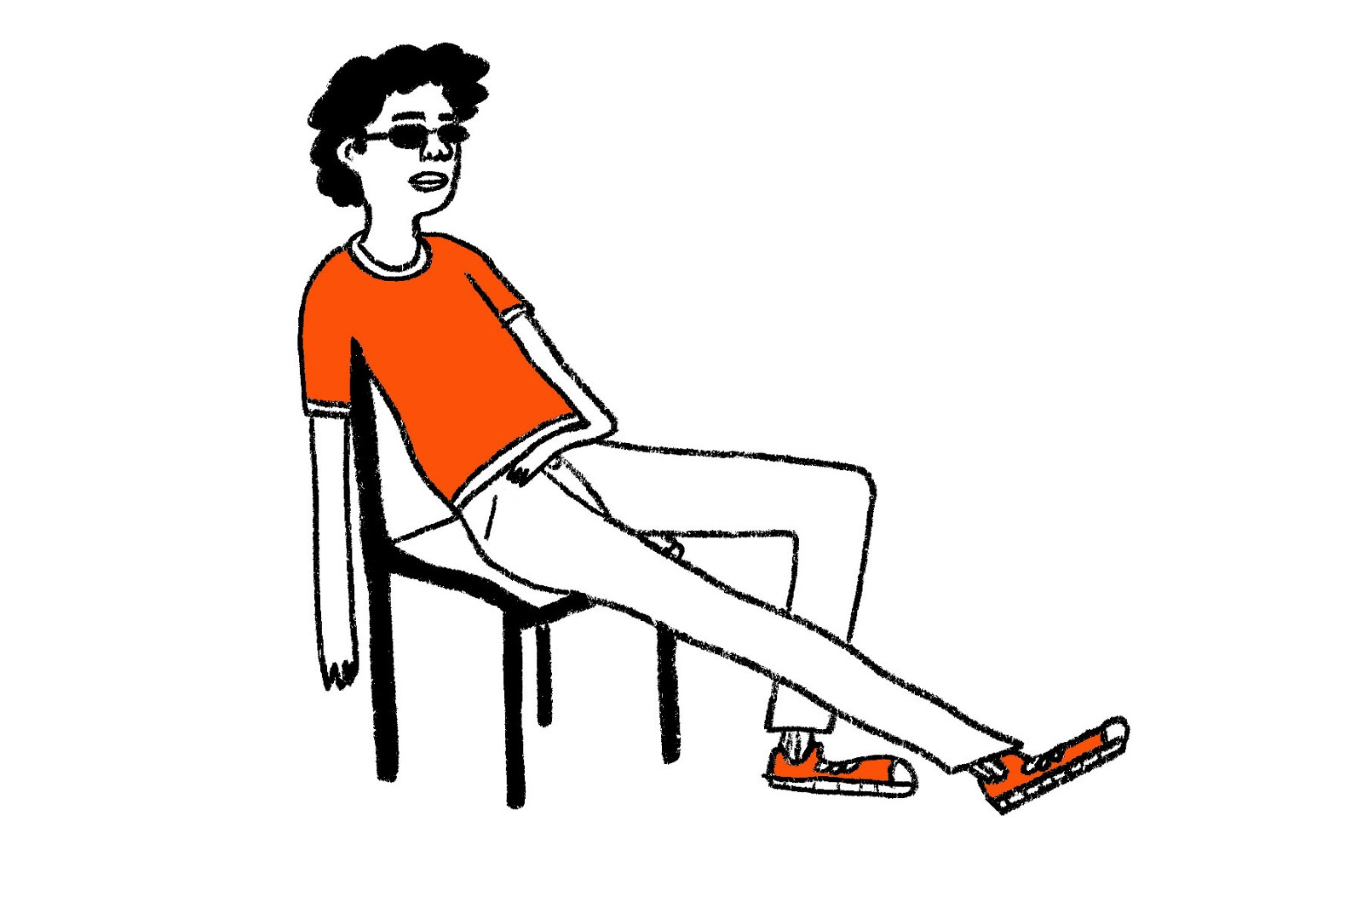
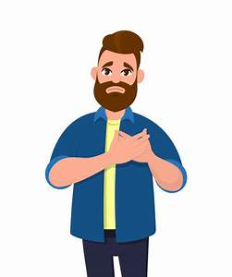
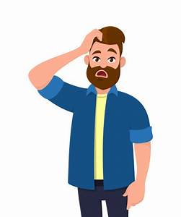

BODYLANGUAGE
Facial expression
Eye contact/ gaze
Gestures
Postures
Personal appearance

Slide 22
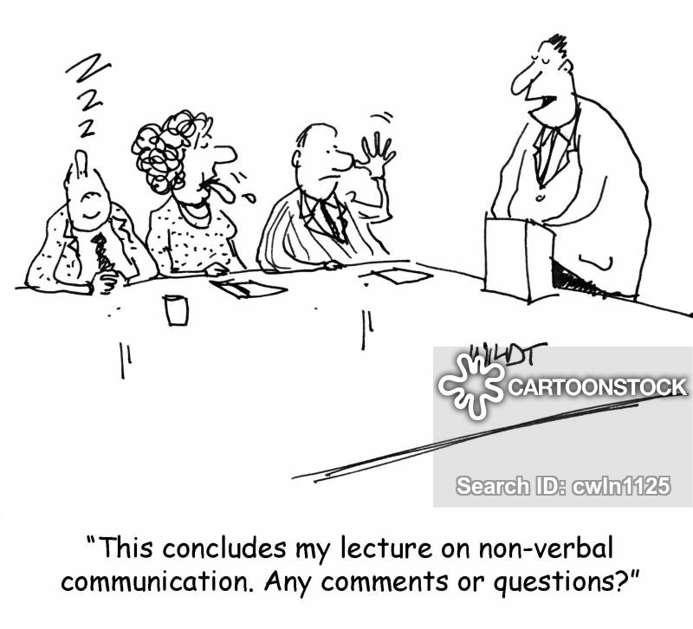

Slide 23
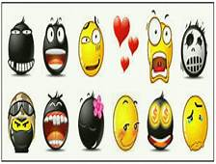

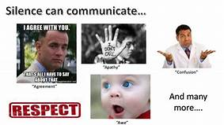
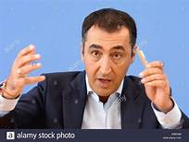
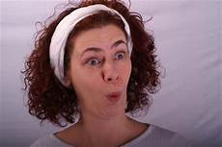
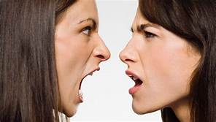
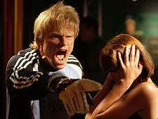
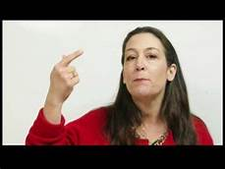
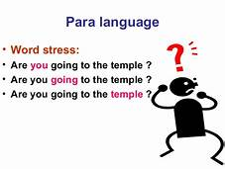
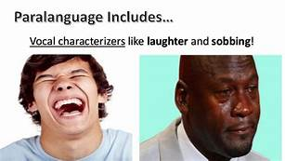
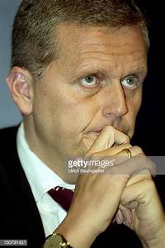
Para Language
Attributes of speaking which include the pitch, the tone,
the volume, tempo, rhythm, articulation, resonance, nasality and
even the accent of the speaker collectively known as paralanguage, we can understand mood and the situation by paralanguage
expressions

Slide 24
QUIZ for Review

Slide 25
Which of the following is positive body language to use when speaking?
Fold your arms or cross your legs
Stand behind a lectern and keep your body hidden
Keep arms open and use open gestures
Don't make eye contact
You're giving someone verbal feedback about some work they have completed that isn't up to standard: what should you do?
Point out everything that they did wrong
Base your feedback on what you have heard from others
Criticise them for their poor work
Suggest where improvements can be made and agree on a plan
Which of these is the best way to ask a question?
Only offer a yes/no response
Use open questions that encourage a full response
Use leading words to suggest the response you require
Ask something that you wouldn't want to answer yourself
You disagree with what someone has said: how should you react?
Ask questions to learn more about their opinion
Be unreasonable and refuse to listen
Get emotionally involved and have a heated discussion
Stick with your one-sided view on the situation

Slide 26
Which of the following will NOT help you to be more persuasive?
Mirror body language and tone
Use words that the other person agrees with
Talk about your own interests and goals
Make your aims appear to put the other person at an advantage
Which of these is a communication skill?
A) talking clearly
B) chewing gum
C) looking bored
Which of these is a communication skill?
A) talking at the same time as someone else
B) listening to what people say
C) putting your fingers in your ears
Which of these is not a communication skill?
A) running
B) texting
C) chatting to people

Slide 27
What body language shows you are listening?
A) turning away from the speaker
B) nodding and making eye contact
C) looking out of the window
Which of these is not a communication skill?
A) laughing
B) swimming
C) asking questions
Which of these is a communication skill?
A) checking the weather forecast
B) checking the time
C) checking that you've understood someone
Which of these is a communication skill?
A) saying the same thing over and over
B) saying why you believe something
C) saying what people want to hear
If you don't agree with someone else, what would you say?
A) You are wrong.
B) I don't agree.
C) Stop talking rubbish.

Slide 28
You have a discussion with a friend about politics. You don't agree
with them. What should you do?
A) change the subject
B) say what you believe
C) get angry with your friend
Which of the following is not a barrier to communication?
Language
Noise
Distraction
Body Language
An example of non-verbal communication is
talking on the phone
texting on the phone
Emailing
Waving
All of the following are examples of effective communication skills except.
Arms crossed.
Open body posture.
Eye contact
Calm voice

Slide 29
Which of the following is not a way to show that you are listening to someone?
Make eye contact
Turn your body away from the speaker.
Nod
Ask questions
What is a way to identify when someone is interested in a topic you are talking about?
They are looking at their watch
They change the subject
They ask questions for more information
They yawn
Which of the following is an example of active listening?
Good eye contact
Listener has encouraging facial expressions.
Listener shows interest in person
All of the above.

Slide 30
